Slide 1
NATURAL GAS PRICE PREDICTION
Project by team-CSE027
V.AMULYA
J.SHRUTHI
K.MEGHANA
R.PRAVALIKA

Slide 2
contents
Introduction
About our project
Experimental investigation
User interface
Result
conclusion

Slide 3
INTRODUCTION
Natural Gas has been proposed as a solution to increase the security of energy supply and reduce environmental pollution around the world.
Being able to forecast natural gas price benefits various stakeholders and has become a very valuable tool for all market participants in competitive natural gas markets.

Slide 4
ABOUT OUR PROJECT
Prediction of Natural Gas Price, commercially is important to know. The purpose of this model is to predict the spot price of Natural Gas when the date is taken as the input given by the user. It then predicts the price of the Gas on that specific day.
In this model, we are using the Machine learning algorithms to help predict the values. We chose Decision Tree Regression Algorithm in this model.

Slide 5
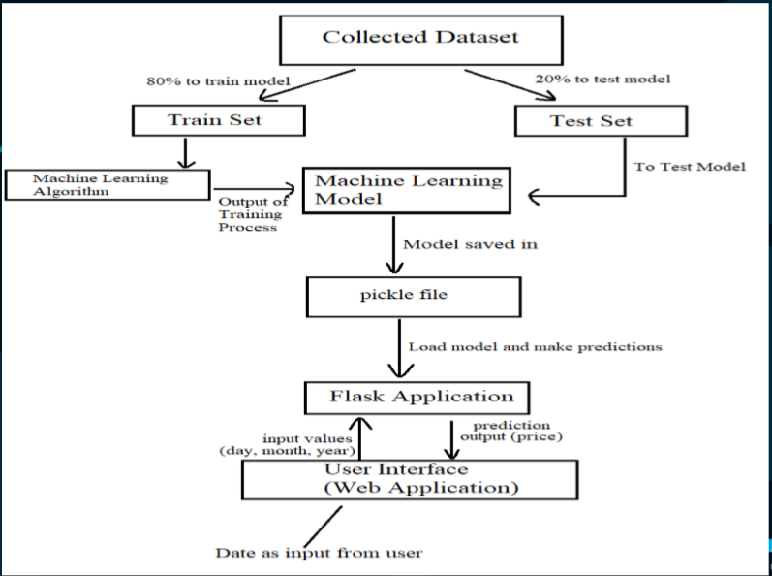

Slide 6
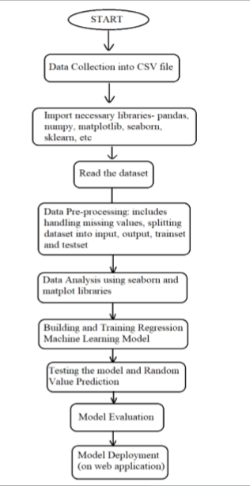
EXPERIMENTAL INVESTIGATION
Flowchart:
This flowchart indicates the process followed for building and implementing the model.

Slide 7

USER INTERFACE (WEB APPLICATION)
->The interface (UI) is that the point of human-computer interaction and communication during a device.
->It is the way through which the user interacts with an application or a website.
->The application is created using Flask app.
->The UI is developed using html5, CSS3, and bootstrap.

Slide 8
RESULT
The Result predicted is shown in the image. We used Decision Tree Regression because it has an accuracy of 97.55%.
The model is then integrated to our UI, which predicts the price of Natural Gas.

Slide 9
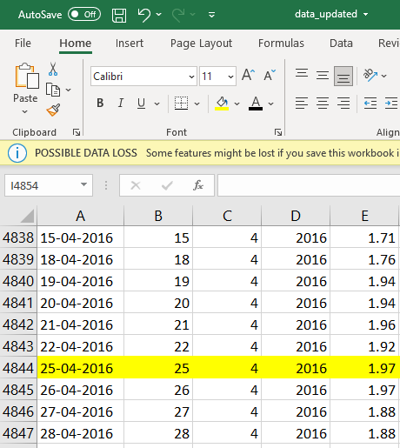

Comparison of price on date 25-04-2016 in the dataset and the UI

Slide 10
Let’s watch the live demo of our working project, to see the predicted values for the date given as the input.
http://localhost:5000/

Slide 11
CONCLUSION
The beautifully designed UI is an attractive and a user-friendly page, that satisfies the user by giving the required information.
THANK YOU

